Slide 1


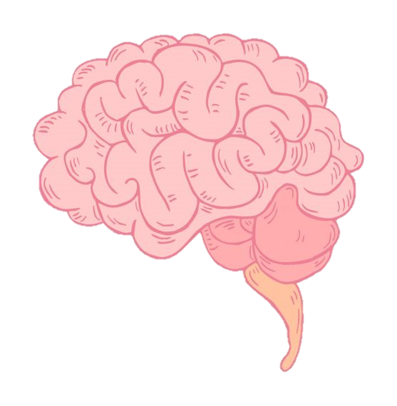
Mental Health Support Team!
Let’s talk anxiety!
Notes:
Yasmin

Slide 2


Who am I?
My name is Yasmin!
I work as an EMHP within your Mental Health Support Team!
My job is to help you understand and look after you brain!
Notes:
Yasmin

Slide 3

Let’s talk Anxiety!
What is anxiety?
Is anxiety always bad? (The Fight, Flight, Freeze response).
How do I know when I’m anxious?, how does my body feel?
Situations when my anxiety is helpful?
When does anxiety become a problem? (The Worry Cycle).
How can I feel better when I’m anxious?
Notes:
Yasmin

Slide 4
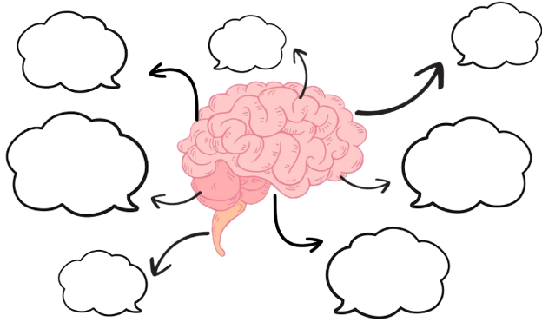
What is anxiety?
Notes:
Yasmin

Slide 5


What is anxiety?
ANXIETY IS A HORMONAL REACTION THAT TAKES PLACE IN OUR BODIES!
Anxiety is caused by us thinking that something bad is going to happen!
These thoughts tell our BRAIN that we might be IN DANGER!
When on brain thinks this, IT RELEASES HORMONES into OUR BODY To help us protect ourselves!
Think of anxiety as your bodies personal fire alarm!

Slide 6
Is anxiety always bad?
The short answer is no, Anxiety is not always bad, and can be really helpful sometimes!
Anxiety is a normal response, and actually means our brain is healthy!
Everybody in the whole world will experience anxiety sometimes!
Experiencing anxiety does not mean there is something wrong with you!
Believe it or not, we are born with anxiety, and its main job is to keep us safe!
Notes:
Yasmin

Slide 7


The fight, flight, freeze response!
When our anxiety alarm goes off, this is called the fight, flight, freeze response!
This is our bodies way of keeping us safe from danger!
This is a normal reaction that happens in our body, and it is trying to help us! Even though it might not feel like it sometimes!
fight
Flight (run away)
Freeze (hide)
Notes:
Sophie

Slide 8



How does my body respond?
Notes:
Sophie

Slide 9
Situations when my anxiety
is helpful!
So, we know that anxiety is not always bad! And we know that anxiety is actually there to help us!
Let’s think about some situations when anxiety can be really helpful!

Slide 10


When does anxiety become a problem?
Anxiety can become a problem if:
- Your alarm is going off all the time!
- your physical symptoms are consistent!
- your worries are stopping you from doing things you need/want to do!
Let’s have a think about your triggers for anxiety, and the thoughts you have about them!

Slide 11



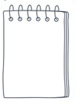


The worry cycle!
My thoughts…
My body…
My behaviour…
My feelings…

Slide 12

How can I feel better when this happens?
When we notice ourselves becoming anxious, it can help us feel better if we can learn how to turn our alarm off!
The easiest and quickest way to do this, is by learning to control our physical symptoms!
Let’s look at some strategies and techniques that can help us!

Slide 13
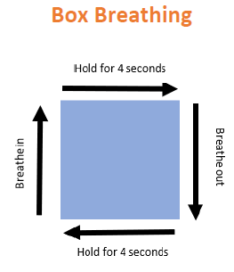
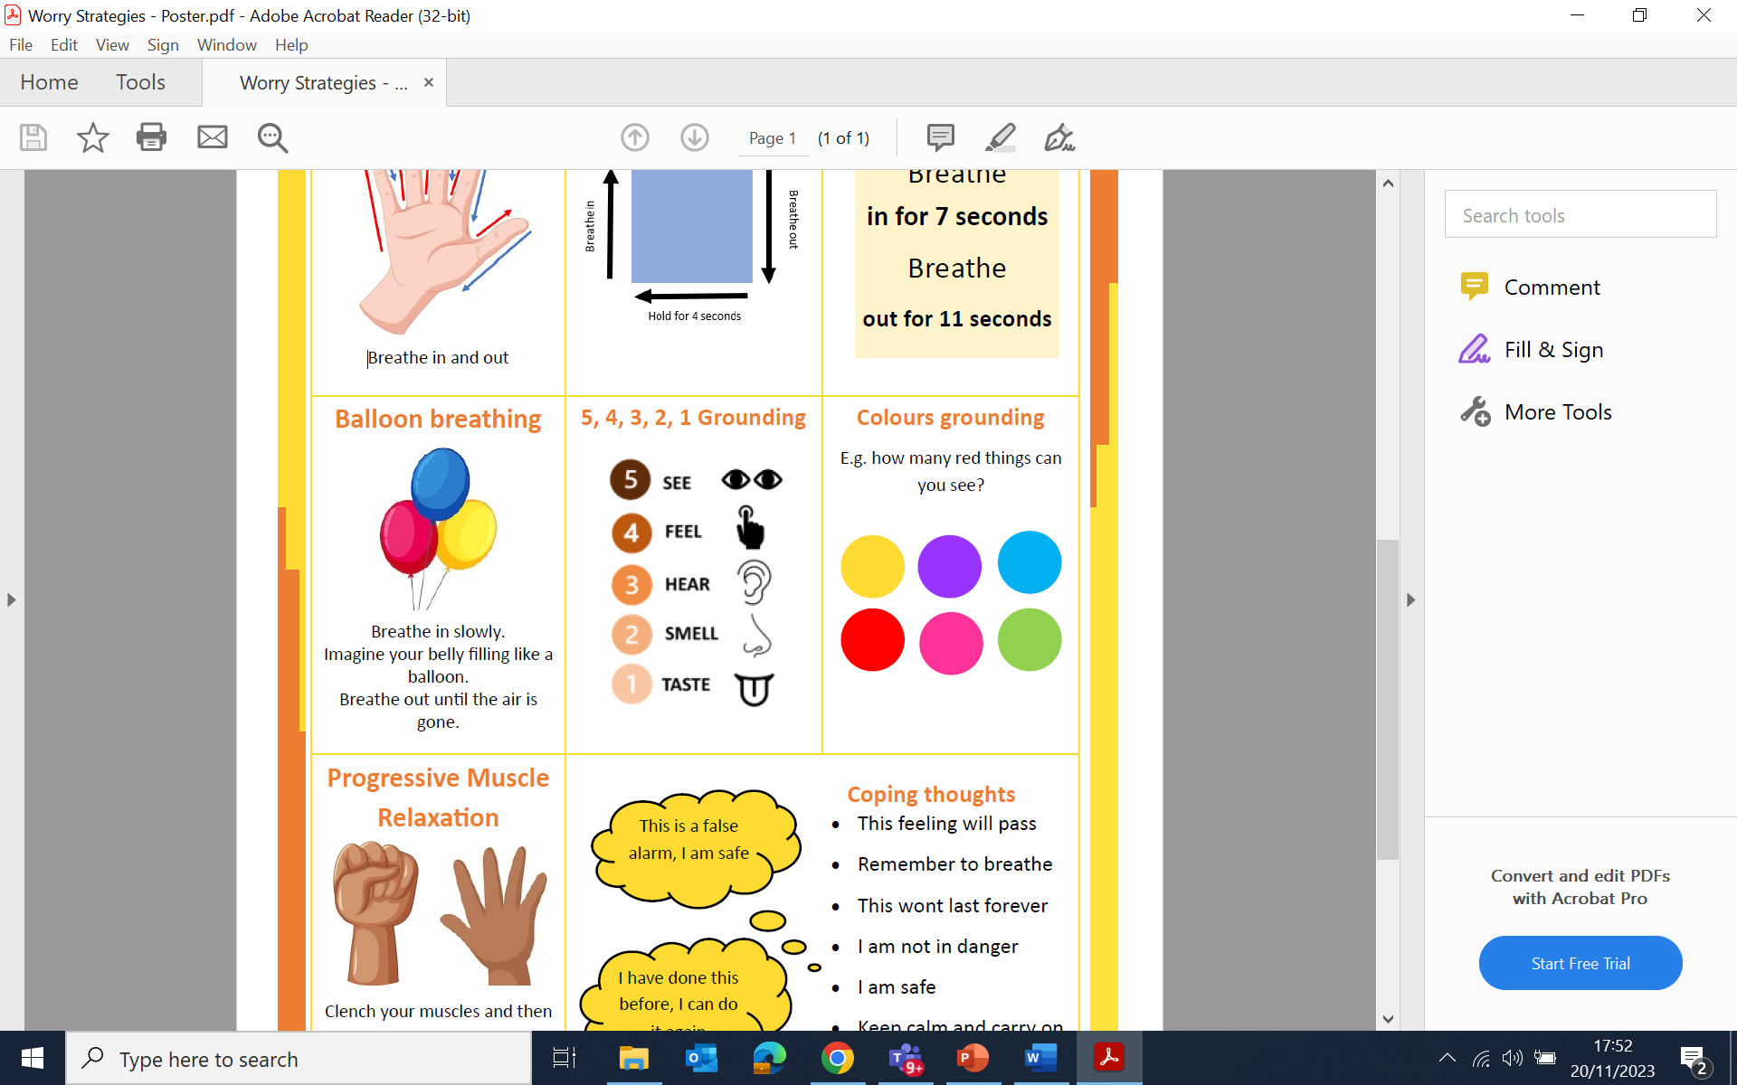
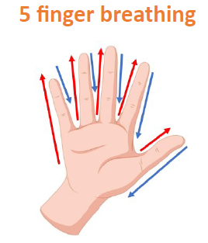
How can I feel better when this happens?

