Slide 1
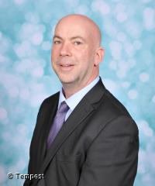
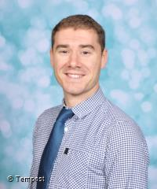
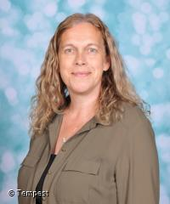
Here to listen: our safeguarding team
Designated safeguarding lead (DSL):
Paul Baddeley
Contact details: head@holywell.cambs.sch.uk
[Paste a photo of your deputy DSL in here]
Deputy DSL: Guy Turner
gturner@holywell.cambs.sch.uk
Deputy DSL: Katherine Mullee
kmullee@holywell.cambs.sch.uk

